Slide 1
A review of equitable revenue sharing in Kenya
May 31, 2018

Slide 2
Overview
Review of intergovernmental finances in Kenya under the first and second bases for revenue sharing
Seeks to inform development of third basis for equitable revenue sharing
Review looks at current system from three perspectives:
  Where does ES fit into the wider intergovernmental finance system?
  Review / analysis of current allocation pattern: is the money going ‘where it should’?
  Technical review of the horizontal allocation formula: does the ES adhere to good transfer design practices?

Slide 3
Role of ES in the intergovernment finance system
Before considering the horizontal allocation of the Kenya ES, what role does it play?
Different countries have chosen different options...

Slide 4
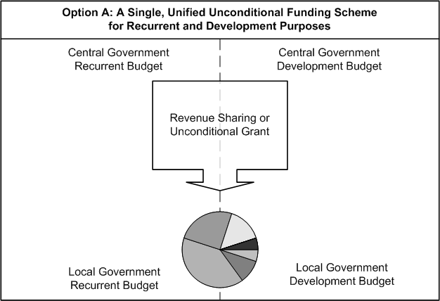
Overall structure of the transfer system: Option A

Slide 5
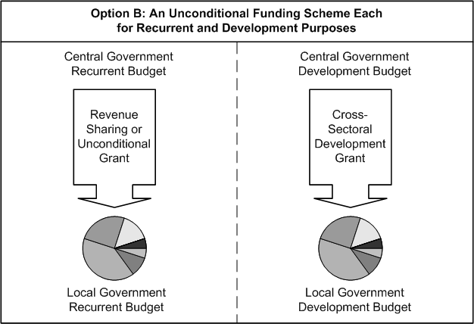
Overall structure of the transfer system: Option B

Slide 6
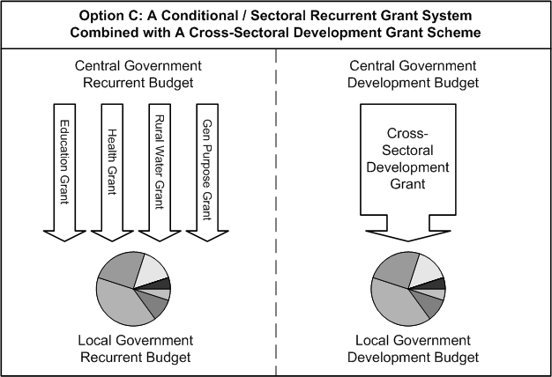
Overall structure of the transfer system: Option C

Slide 7

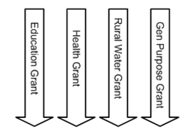
Overall structure of the transfer system: Option C’

Slide 8
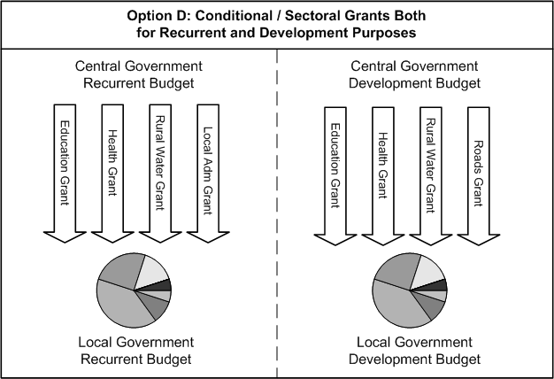
Overall structure of the transfer system: Option D

Slide 9
Kenya choose (mostly) Option A
Does not work well in countries where subnational government are NOT effective, responsive and accountable : e.g., Nigeria
Risks under-funding important local public services
Formula can be used to link financial allocation to subnational functions and expenditure responsibilities
Good example: South Africa’s Provincial Equitable Shares (PES)
Can work well in countries where subnational government are effective, responsive and accountable: e.g., Germany, Canada

Slide 10
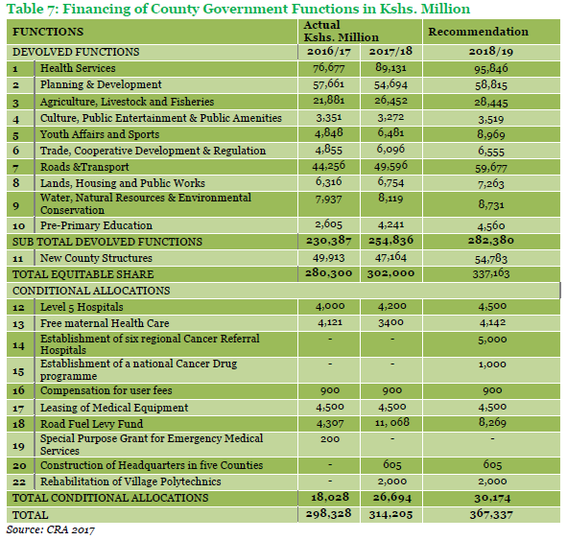
Kenya: “Finance follows functions” ?
Vertical allocation of ES in Kenya is driven (in part) by functional assignment...
... but horizontal allocation of ES is only (very) loosely driven by functional assignment
  The horizontal allocation loses the link between the allocation of funds and the functional responsibilities of counties

Slide 11
South Africa PES example:
“Finance follows functions” (1)
Provincial Equitable Shares (PES) formula consists of six components that capture the relative demand for services amongst provinces
Health, Education, Basic, Poverty, Institutional and Economic
4 of the 6 components rely on population figures
The weighting per component does not prescribe how the PES should be spent
The money is unconditional therefore allowing provinces the flexibility to budget their resources the best way possible in order to provide services to their people

Slide 12
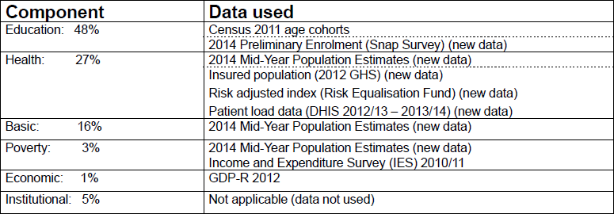
South Africa PES example:
“Finance follows functions” (2)
Total PES Fund: Rand 383 billion (2015/2016)
PES = Ed + H + B + P + Ec + I
For instance: Eastern Cape Province has 1.9 million out of total 12.4 million school-aged population (15%)
  R ( 0.48 * 383 bn) /12.4 mn = R 14,825 per school-aged child
  R ( 0.48 * 383 bn) * (15%) = R 27.6 billion

Slide 13
Affordable client-based financial norms versus “costing expenditure needs”
A “costing approach” results in unaffordable (wish-list) service delivery standards
  Each sector will set high service delivery standards without regard to affordability
  Costing of unaffordable standards will perpetuate unrealistic expectations and result in failure of counties to meet these expectations
A functional approach results in affordable client-based financial norm for services
  Based on the client-based financial norms, work with sectors to provide counties with planning guidance for service delivery (within resource constraint)

Slide 14
The role of own source revenues in intergovernmental finances in Kenya
In many countries (e.g., Russia, Germany, Nigeria, Indonesia, Ethiopia) subnational governments have considerable own and shared revenues - which needs to be equalized
By constitutional design, only a limited role for own source revenues in Kenya ( <10% of county finance)
Similar to provinces in South Africa (3%), local governments in the Netherlands (4%) and many other unitary countries
As such, revenue equalization is much less relevant in Kenya than in some other decentralized systems

Slide 15
Revenue equalization and stimulating revenue effort (1)
Fiscal capacity (revenue potential) reflects the ability of a local government to generate revenues or the revenue potential.
Fiscal capacity is extremely hard to measure properly:
  Actual local revenue collections are not a good measure of revenue capacity (nor of revenue effort)
Fiscal capacity equalization is often more appropriate for larger (federal) countries

Slide 16
Revenue equalization and stimulating revenue effort (2)
Fiscal effort (actual revenue collections as a proportion of fiscal capacity) is equally hard to measure
  Revenue increase over time is also not a good measure of fiscal effort
Hard to stimulate revenue effort through performance (grant) incentives
More important: ad hoc grants provide a major disincentive for collecting own source revenues (in contrast, a well-designed formula-based grant provides a hard budget constraint)

Slide 17
Balancing different objectives in Kenya
Article 203 of the Constitution assigns different—sometimes competing—objectives to the equitable revenue sharing formula, e.g,:
  the need to ensure that county governments are able to perform the functions allocated to them;
  economic disparities within and among counties and the need to remedy them;
  to provide incentives for each county to optimise its capacity to raise revenue;
The allocation formula (implicitly or explicitly) needs to balance these competing objectives:
  Not enough redistribution may cause political instability
  Too much re-distribution may cause under-funding of areas that are Kenya’s engines of economic growth

Slide 18
Analysis of horizontal distribution of Equitable Shares allocations

Slide 19
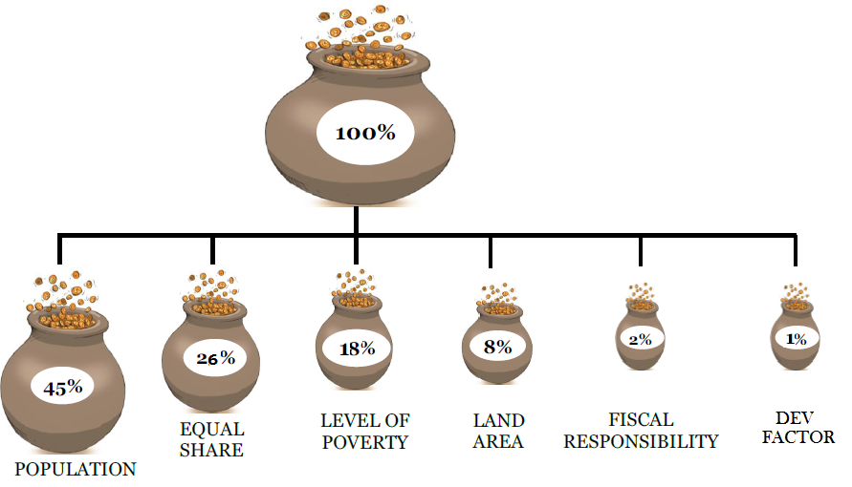
Basis for distributing Equitable Shares: FY 2013/14 – 2018/19
Parameter | First basis % weights FY 2013/14 – 2015/16 | Second Basis % weights FY 2016/17 -2018/19
Population | 45% | 45%
Equal Share | 25% | 26%
Poverty | 20% | 18%
Land Area | 8% | 8%
Fiscal Effort | 2% | 2%
Development Factor | - | 1%

Slide 20
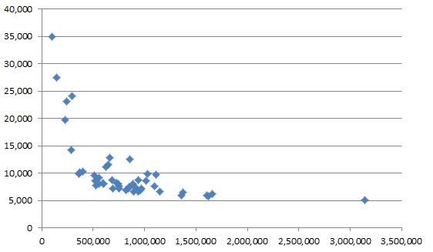
Per capita ES allocation, FY 2018/19 (1)
National average – Ksh 8,000
Unweighted avg. – Ksh 10,000
Are the small (least populous) Counties getting too much?
Are the large (highly populous) Counties getting enough?

Slide 21
Implication of 2018/19 ES formula: mathematical equivalence
Parameter | Second Basis % - KSh | Per Client / Unit Allocation (KSh) | Per Client / Unit
Population | 45% - 141.3 bn | 2,910 | Person
Equal Share | 26% - 81.6 bn | 1.7 billion | County
Poverty | 18% - 56.5 bn | 2,580 | Poor Person*
Land Area | 8% - 25.1 bn | 43,200 | Square Kilometer
Fiscal Effort | 2% - 6.3 bn | 5.1 million | Per Cap. Rev. Increment
Dev. Factor | 1% - 3.1 bn
But, how does this distribution link to county functions?

Slide 22

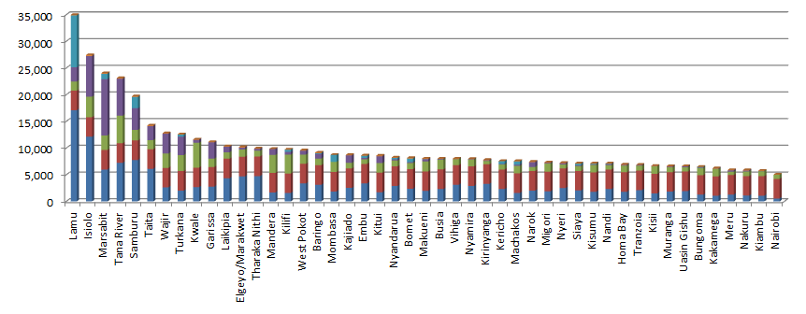
Per capita ES allocation, FY 2018/19 (2)

Slide 23
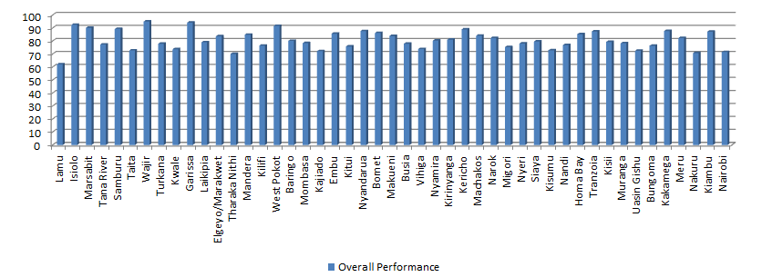
Budget execution performance

Slide 24
Technical review of the horizontal allocation formula

Slide 25
Universally accepted principles of sounds transfer design (1)
Principle | Meaning | Assessment
1. Clear objective | Clear stated objective | No clear objective(s)
2. Revenues adequacy | Transfers should provide adequate resources for purpose at hand (avoid unfunded mandates) | Unclear, as objective is unclear and there are no costed service delivery standards
3. Preserving budget autonomy | Conditions placed on transfers should balance national priorities and local autonomy | County autonomy is important, but current fornula under-emphasizes constitutional responsibilties of CGs
4. Enhancing equity and fairness | The transfer mechanism should support a fair allocation of resources | Seems pro-poor (OK)
5. Stability | Allocation should be predictable over time | OK

Slide 26
Universally accepted principles of sounds transfer design (2)
Principle | Meaning | Assessment
6. Simplicity and transparency | Mechanism should be simple and transparent | Generally OK, but some variables unclear: - Poverty gap - Development index
7. Incentive compatibility | Approach should not provide negative incentives | Problem with fiscal effort measure Poverty is NOT a problem
8. Focus on service delivery | Transfer formulas should focus on the demand (clients or outputs) rather than the supply (inputs and infrastructure) of local government services | In principle OK, but link to clients is quite unclear Are urban services being under-funded?

Slide 27
Universally accepted principles of sounds transfer design (3)
Principle | Meaning | Assessment
9. Avoid equal shares: | Excessive reliance on the “equal shares” principle as a major allocation factor should be avoided | Current weighting is quite high (preferable no more than 20%)
10. Avoid sudden large changes | Avoid sudden large changes in funding for local governments during the introduction of the new transfer mechanism | Generally, ok but: Some concern about inherited staff Going forward, avoid major changes

Slide 28
Characteristics of desirable allocation factors (mostly OK in Kenya)
Accuracy: The variable should accurately reflect the specific characteristics and should be statistically sound.
Regularly updated: The variable should be regularly updated in the future.
Independent source: The variable should come from an independent source respected by all stakeholders
Free of local manipulation: The variable should be drawn from a source that cannot be manipulated by local governments

Slide 29
Technical review: factor-by-factor (1)
Factor | Measure / data | Comment
Equal Share (26%) | 1/47 | Weighting seems to imply very high ratio of fixed cost vis-à-vis variable costs of County government. Is the resulting variation in per capita allocations excessive?
Population (45%) | Census. | Since people are the ultimate client of county services, this should indeed be the main allocation factor. Introduce urban population and rural population as additional allocation factors? Can we use more nuanced meaures of population / clients for different functions?
Poverty (18%) | Poverty gap | Link to be established between poverty and county service delivery functions, and weighting to be reviewed accordingly (Poverty headcount more transparent)

Slide 30
Technical review: factor-by-factor (2)
Factor | Measure / data | Comment
Land area (8%) | Land area (sq km) | Land area and service delivery cost do not have a linear relationship. “Why are we funding land?” Should land area be capped?
Fiscal effort (2%) | Per capita rev increment (COB) | Inadequate measure of fiscal effort. Iratic measure / likely ineffective approach to promoting fiscal effort Main way to promote fiscal effort: hard budget constraint What about budget execution performance ?
Development factor (1%) | Unclear | Lacks transparency; does not have a major impact on distribution of resources

Slide 31
Concluding Thoughts:
Towards a Third Basis

Slide 32
Options for the Third Basis
Continue with same formula
Minor modification of existing formula (e.g., revision of factor weights)
Move to a “function-based” formula, relying on basic measures of expenditure needs for each component of the formula
Move to a “function-based” formula, using performance-based measures of expenditure needs (e.g., health attendances)

Slide 33
A possible function-based formula
Clarify policy objective(s)
A closer link between policy objectives (including county services) and finances would be desirable
  Data for allocation factors continues to be constrained
Revisit some of the more problematic features of the current formula
  Reduce proportion allocated based on equal shares
  Measure of fiscal effort is causing distortions
  Should land area be used (if so, capped)?

